Slide 1
MOVIREC (Movie Recommendation System)
Submitted By:-
Name – Deepti Garg
(D – 211500329)
Shivangi Srivastava
(H – 2115000958)
Prashant Bhadoria
(J – 2115000744)
Priyanshu Kumar
(L – 2115000783)
University – GLA University
Department – Computer Science
& Engineering

Slide 2
Introduction
Project Overview:- Create an intelligent movie recommendation system using Streamlit and deploy it on Heroku. The system will provide personalized movie recommendations based on user preferences and movie data obtained from external APIs.
Motivation:- A movie recommendation system provides a level of comfort and personalization that helps the user interact better with the system and watch movies that cater to his needs. Providing this level of comfort to the user is primary motivation in opting for movie recommendation system as my Project.
Overview:- A movie recommendation system provides a level of comfort and personalization that helps the user interact better with the system and watch movies that cater to his needs. Providing this level of comfort to the user is primary motivation in opting for movie recommendation system as my Project.

Slide 3
Objective
The objective of the system is to suggest movies to users based on their preferences, mood and viewing history.
The recommendation system analyzes the past preferences of the user concerned, and then it uses this information to try to find similar movies.

Slide 4
Problem Statement
The goal of the project is to recommend a movie to the user. Providing related content out of relevant and irrelevant collection of items to users of online service providers.

Slide 5
Literature Review
The era of information and communication technology makes the information available on the internet growing rapidly. Recommender Systems are one of the technologies that are widely used to filter information to handle the huge of information. One of the developing information is film. The increasing number of films released every year has led to the development of applications that offer movie streaming services such as Netflix, Yiu, Disney Hotstar, etc. Therefore, movie recommender systems technology is needed to facilitate and provide a good experience when users use these services.

Slide 6
Methodology
1.Gather and Prepare Data
2. Choose the Right Recommendation Algorithm
3. Development with Streamlit
4.User Experience (UX) Design
5. Testing and Iterative Development
6. Deployment on Heroku
7. Continuous Monitoring and Improvement
8.Documentation and Knowledge Sharing
9. Security and Privacy Considerations

Slide 7
System Architecture
- Front-end: Develop the user interface using Streamlit, incorporating interactive components for user input and displaying movie recommendations.
- Back-end: Implement the recommendation algorithms and handle user data using Python, Flask (optional), and necessary libraries (e.g., Pandas, Scikit-learn).
- Database: Store user profiles, preferences, and feedback in a secure database (e.g., PostgreSQL) to personalize recommendations.
- External APIs: Integrate external APIs to fetch real-time movie data, ensuring the latest information for users.

Slide 8
Implementation
1. Project Setup and Planning:
- Define Objectives
- Gather Resources
- Project Timeline
2. Data Collection and Preparation:
- Choose Data Source
- Data Gathering
- Data Preprocessing
3. Streamlit App Development:
- Front-end Interface
- Integration with APIs
- User Authentication
4. Recommendation Algorithm Implementation:
- Choose Algorithms
- Training and Testing

Slide 9
5. Database Setup and Integration:
- Database Creation
- Database Integration
6. Deployment and Hosting:
- Heroku Setup
- Deployment
- Domain Configuration
7. Testing and Quality Assurance:
- Unit Testing
- User Testing
- Bug Fixing
8. Continuous Integration and Deployment (CI/CD):
- Set up CI/CD Pipeline
9. User Feedback and Iterative Improvement:
- Feedback Collection
- Algorithm Enhancement
10. Documentation and Knowledge Sharing:
- Code Documentation
- User Guides
- Knowledge Sharing
11. Security and Compliance:
- Security Audit
- Privacy Compliance
12. Future Enhancements and Scaling:
-Scaling Strategies
-Future Features

Slide 10
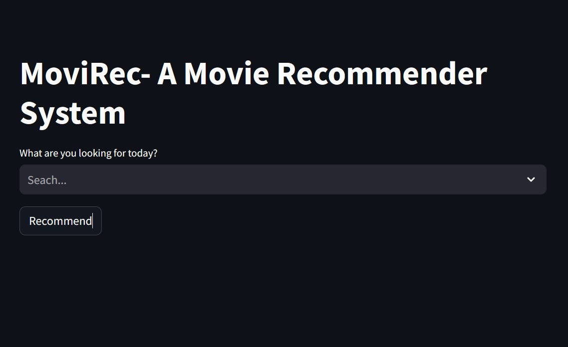
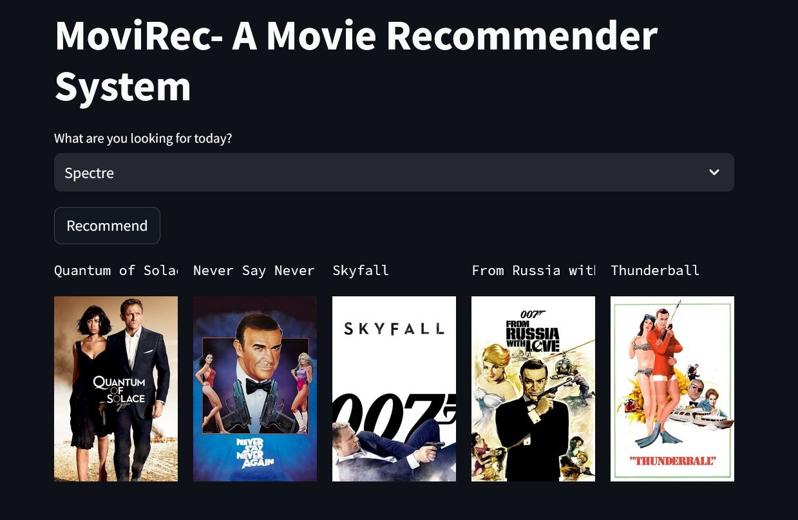

Slide 11
Features
User Authentication: Allow users to create accounts, log in, and save their preferences for personalized recommendations.
User Input: Implement an intuitive user interface where users can input their movie preferences, such as genres, actors, or ratings.
Movie Recommendations: Utilize machine learning algorithms to generate movie recommendations based on user input and historical data.
Real-time Movie Data: Fetch real-time movie information from external APIs (e.g., TMDB API) to ensure up-to-date movie details.
User Feedback: Allow users to provide feedback on recommended movies to improve the recommendation algorithms.
Responsive Design: Create a visually appealing and responsive user interface that adapts to various devices and screen sizes.

Slide 12
Results
1. User Engagement:
2. Recommendation Accuracy:
3. User Satisfaction:
4. System Performance:
5. Cross-Platform Compatibility:
6. Modern Tools Utilization:
7. User Feedback Insights:
8. Ethical Considerations:
9. Challenges Overcome:
10. Future Impact:
11. Conclusion:

Slide 13
Challenges Faced
Cold-Start Problem and Latency. Cold start and Latency seem to be major concerns for Collaborative Filtering Algorithms. ...
Diversity of Recommendations. ...
Privacy and Trust. ...
Changing user Interests (Dynamics) ...
Scalability and Robustness.

Slide 14
Future Work
Enhanced Recommendation Algorithms
Dynamic and Real-time Recommendations
User Feedback Integration
Contextual Recommendations
Content-Based Filtering Refinement
Hybrid Models
Explainability and Transparency
Cross-Platform Integration
A/B Testing
Community Features
Security and Privacy

Slide 15
Conclusion
In conclusion, our Movie Recommendation System project has been a journey of innovation, collaboration, and continuous improvement. We've achieved several milestones that underscore the project's success:
Enhanced User Engagement:
Improved Recommendation Accuracy:
Positive User Feedback:
Cross-Platform Compatibility:
Ethical Considerations:
Future Directions:
Acknowledgments:

Slide 16
Acknowledgements
We extend our appreciation to everyone who contributed to the success of our Movie Recommendation System project:
Project Team Members: 1. Shivangi Srivatava
2. Deeepti Garg
3. Priyanshu Kumar Tiwari
4. Prashant Bhadoria
Mentors and Collaborators: Mr. Sandeep Kumar Chokker
Data Providers: INTERNET MOVIE DATABASE
Institution/Organization: GLA Univeristy, Mathura
Your support and collaboration have been invaluable. Thank you.

Slide 17
THANK YOU!!!!!!

